Slide 1

Intro to Marketing Analytics
Nadav Rindler nrindler@gmail.com
Session 01
23 Feb 2018

Slide 2
Agenda
Course overview, objectives
How businesses use data
Defining marketing analytics
Learning from data
Building and managing an analytics team
Analytics skillset
Delivering analytics projects – approach, workflow
Case study: Pricing experiment

Slide 3
Course Overview
Day 1: Intro to Marketing Analytics
Day 2: Customer Lifetime Value
Day 3: Segmentation
Day 4: Predictive analytics
Part II: Digital Marketing
Day 5: Google Analytics
Day 6: Customer purchase journey mapping
Day 7: Performance-driven email marketing
Day 8: Digital advertising performance analytics (multi-channel)

Slide 4
Objectives
Understand key concepts and methods in marketing analytics and how / when to apply them
Learn to extract valuable, actionable insights about your customers using data
Connect marketing efforts to results
Use analytics to drive decision making – “What should we do?”
Leverage digital marketing channels and analytics (Part 2)
Notes:
Balance of concepts and methods

Slide 5
How businesses use data
Customer insights / experience – who, what, when, where, why, how
Trends – demand, pricing, forecasting, economic conditions, seasonality
Competitive and market analysis
Operations – logistics and supply chain, inventory management, staffing decisions, optimization
People management – identify, recruit, manage, retain employees
“Data products” – digital economy – the data is the product

Slide 6
Marketing Analytics
Measuring movement towards our business goals.
Moving us towards our business goals.
Using data to make better decisions.
Businesses want to understand why things happen, not just what is happening
“How do I define success?” “How do I measure success?”
Notes:
Specific Measurable Actionable Relevant Timely
Data-driven decision making
Rectangles vs. squares – all KPIs are metrics; not all metrics are KPIs

Slide 7
The Business
Your market environment,
your customers,
their needs,
and how you fulfill them
Your key metrics will arise from understanding your business
Source: https://www.youtube.com/watch?v=VPyKdAWPWS8

Slide 8
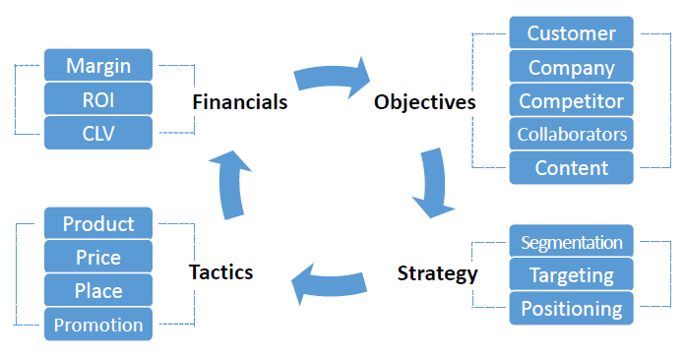
Frameworks – The Marketing Process
Source: Coursera / UVA, Marketing Analytics course

Slide 9
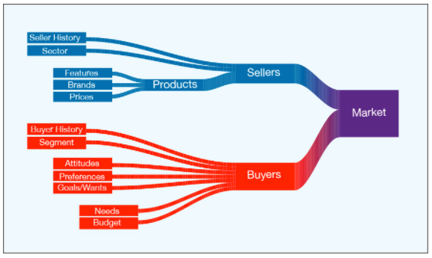
Another Framework – The Market
Source: Marketing Data Science textbook

Slide 10
What are we measuring?
Activity metrics. Number of things done in process, e.g. # new blog posts or # events
Output metrics. Result of process, e.g. web traffic, media mentions, or event participants
Operational metrics. Efficiency and effectiveness of process, e.g. cost per lead, revenue per customer, or cost per customer
Outcome metrics. Consequences of process’ outcomes, e.g. revenue, profit, win rate, share of wallet, or share of market
What to focus on? Depends on who’s asking (CEO, CMO, CFO, etc.) – It should relate to their KPIs
Source: https://en.wikipedia.org/wiki/Marketing_performance_measurement

Slide 11
Common marketing metrics
Track and demonstrate effectiveness of marketing investments across all channels
Financial – ROI, Profit, Gross/net revenue, Cost, Sales
Customer-centric – Number of customers, Customer lifetime value, Customer acquisition cost, Retention/churn, Satisfaction, Net promoter score
Channel-specific
Digital Marketing – Visitors (new/returning), Funnel conversion rate, Avg time on page, page views per session
Social Media – Likes, Followers, Retweets, Shares, Referrals, Social sentiment,
SEO – Keyword performance, Traffic by source, SEO keyword ranking
Email – Sends, Bounces, Opens, Clicks, Unsubscribes, Forwards, Subscribers, Transactions
Source: Klipfolio.com
Notes:
Metrics and KPIs are like squares and rectangles: All squares are rectangles, but not all rectangles are squares. Similarly, all KPIs are metrics, but not all metrics are KPIs.
https://www.klipfolio.com/blog/business-metrics-vs-kpis

Slide 12
Key Performance Indicators
Key Performance Indicators (KPIs) – measurable values that demonstrate how effectively a company is achieving key business objectives
Industry- and topic-specific (e.g., marketing vs. supply chain vs. DevOps)
A KPI is only as valuable as the action it inspires. KPIs set incentives
Must be quantifiable, SMART, clearly-communicated

Slide 13
Why marketing analytics?
Quantify impact. Connecting investments to incremental revenue and profit:
“How much profit would a 10% increase in the marketing budget yield?”
Build transparency, accountability, and credibility. Marketing is not just a cost center, but a driver of results. Must justify resources/budget.
Complement manager expertise with evidence. Test intuition / challenge assumptions
Evaluate performance – design relevant benchmarks for performance
Communicate marketing results to the executive team
Drive strategy – predict the future answer the questions, “What should we do?” and “Where should we focus?”

Slide 14
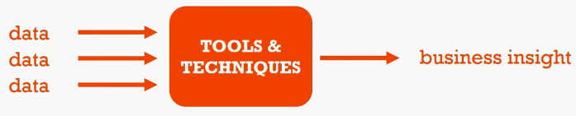
Learning from data
Analytics: Using tools and techniques to turn data into meaningful business insights
Another way to write this: insights = data + methods
Source: https://www.youtube.com/watch?v=9IIgH0hNtgk
Notes:
“Traditional” - “Official” data sources (point-of-sale transactions, supply chain, sales, finance) ingested into enterprise data warehouse
“Big Data” - Unstructured data sources, proliferation of data sources (Twitter, Facebook, sound/image files, web scraping) loaded to Hadoop or Spark
“Excel power-user” - Data from CSV, Microsoft Access database, web sources. Ingest data and analyze in Excel

Slide 15
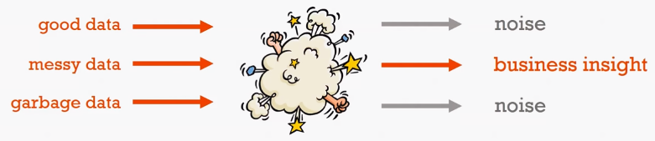
What it actually looks like
Wrestle with data, parse signal from the noise
Source: https://www.youtube.com/watch?v=9IIgH0hNtgk
Notes:
Clean/wrangle data
Parse insights from noise

Slide 16
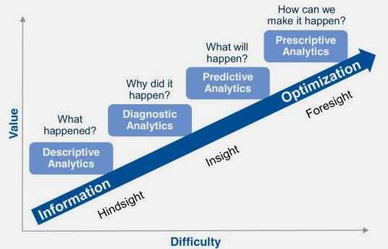
Types of analytics
Descriptive
“What happened?”
“What is happening?”
Diagnostic
“Why did it happen?”
Predictive
“What will happen?”
Prescriptive
“What should we do?”
In order of increasing value-add

Slide 17
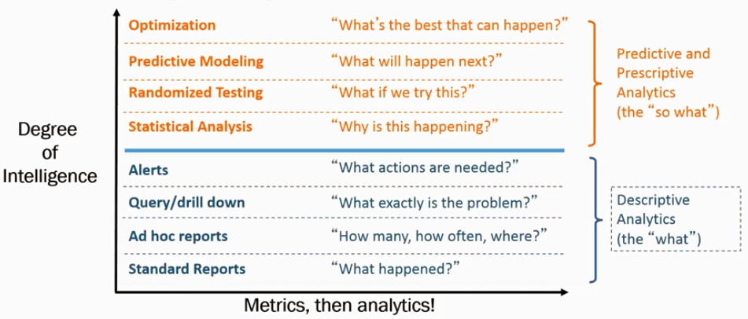
Another look at going up the ladder of intelligence
Source: Coursera / UVA, Marketing Analytics

Slide 18
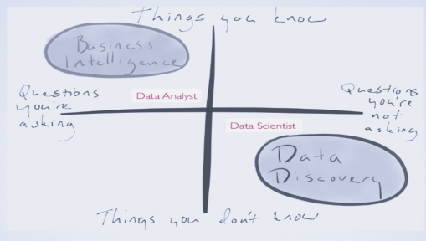
Exploratory vs. Explanatory Analysis

Slide 19
Choosing the right analytic output for the job
Reporting
Profiling, Segmentation
Dashboarding
Forecasting
Predictive modeling
Data as a Service / Algorithm as a Service
Visualization / Storytelling with Data

Slide 20
Things to consider
Data sources
Tools – software, data infrastructure
Methods – data analysis, statistics and machine learning
Approach – scientific method
Objectives – business objective, what story are we trying to tell? Who is our ‘client’?

Slide 21
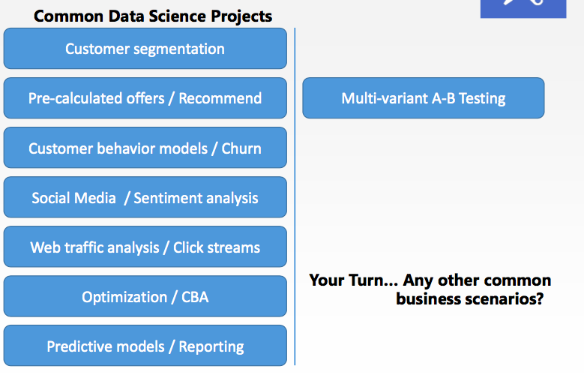
Use cases
Source: Univ. of Washington, DS250

Slide 22
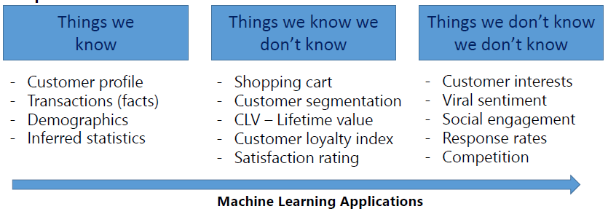
Use cases from explanatory >> exploratory
Source: Univ. of Washington, DS250: Lecture 4

Slide 23
Why the hype about analytics?
Not new methods: long history of statistics and scientific method
Rather, new applications enabled by:
- Exponential growth in data collection, storage, and processing power (Moore’s Law – doubling every 2 years)
- Internet - IoT, cloud hosting
- Open source, open data
- Development of automation, AI
Competitive environment – the leaders are using analytics*
“More than 90% of all the world’s data was created in the last two years.”**
*Davenport (2007), Competing on Analytics ** https://www.sciencedaily.com/releases/2013/05/130522085217.htm

Slide 24
Challenges
Data cleaning difficult and time-intensive
Many formats, including unstructured
Proliferation of tools
Insights depend on data quality
Building an analytics team takes time and effort
Four V’s of Big Data

Slide 25
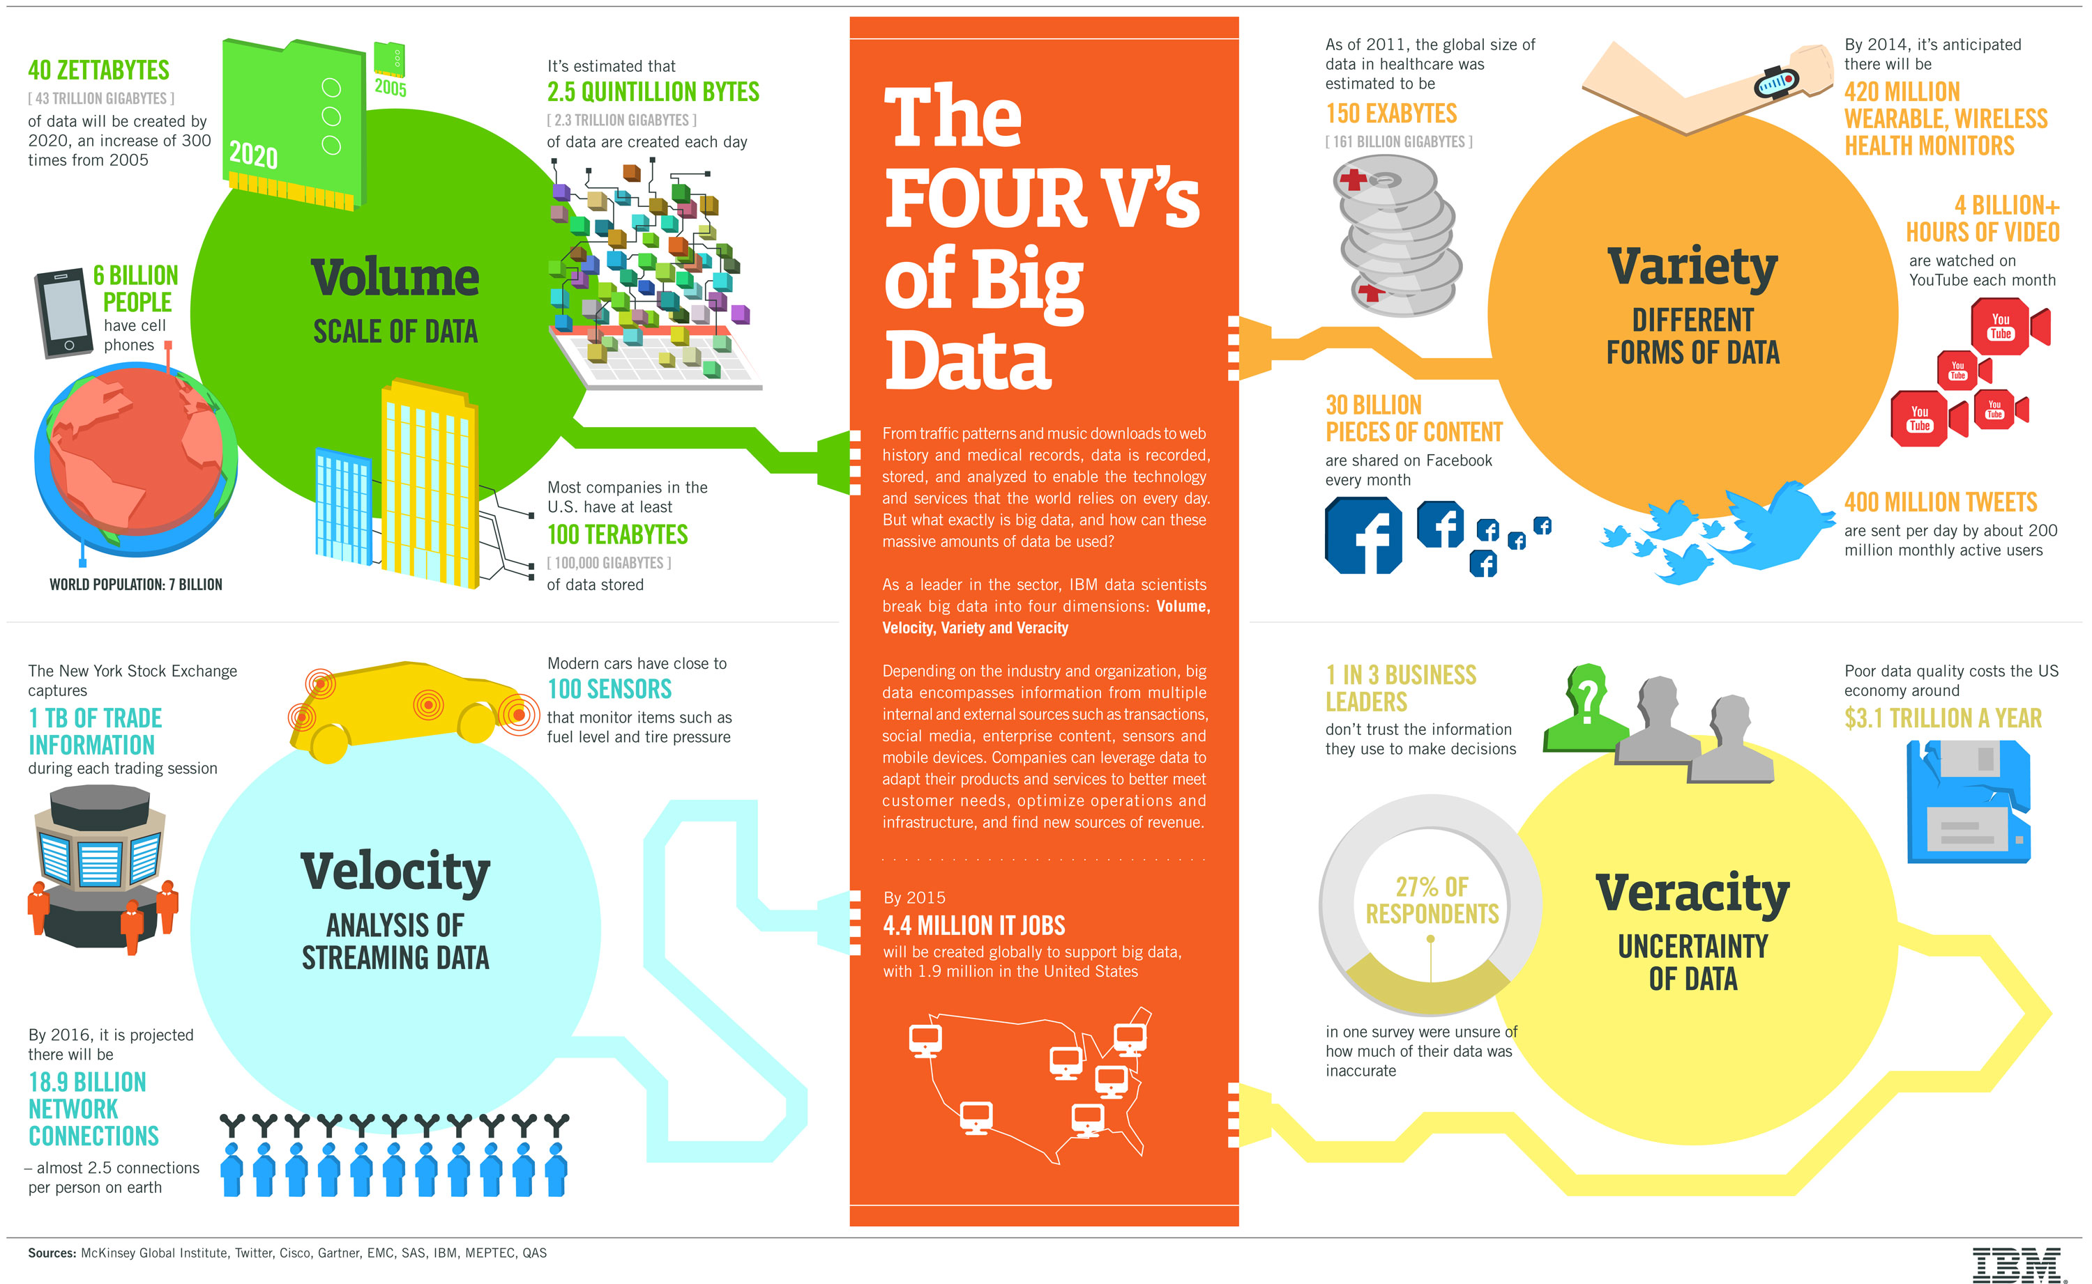
Notes:
Both challenges and opportunities

Slide 26
Building and Managing an Analytics Team

Slide 27
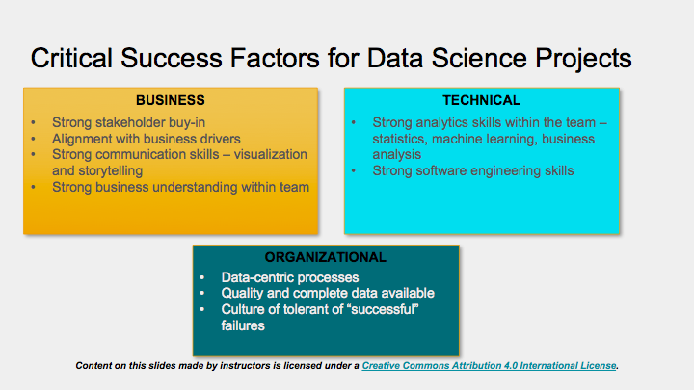
Prerequisites: Skills + Infrastructure + Culture
Notes:
Organizational Context - transformational, creating, as-a-service, crowdsourcing

Slide 28
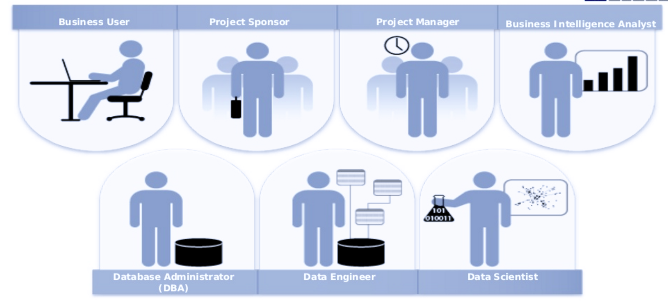
Roles
Source: “Building Data Science Teams” – EMC, presentation
https://www.slideshare.net/emcacademics/building-data-science-teams-31057129.

Slide 29
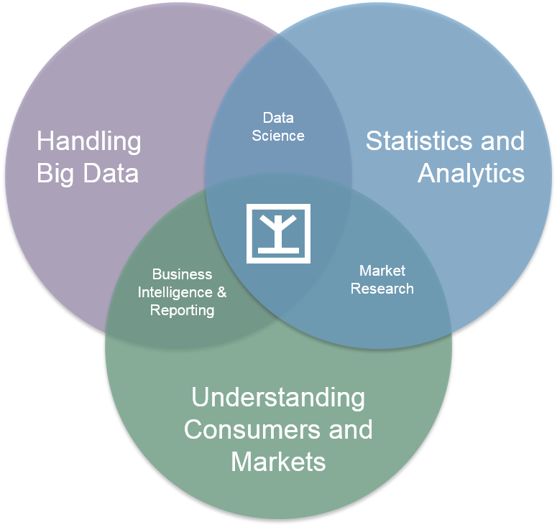
Analytics skill set

Slide 30
Data scientist
Curious, creative, inquisitive
Skeptical - Applies the scientific method
Quantitative - Knows statistics, probability theory, machine learning
Technical - Good at Coding & Hacking
Communication - Good at storytelling of business stories from data
Domain expertise – understands the business
“The best minds of my generation are thinking about how to make people click ads.” – Jeffrey Hammerbacher

Slide 31
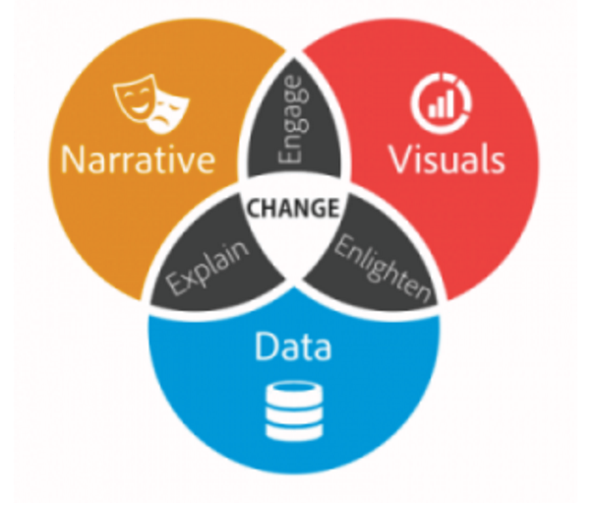
Team Lead
Develop depth and breadth in analytics project
Adept at structured thinking – ability to put structure in place
Create development plan and share with team
Improve data-based business storytelling skills
Source: Brent Dykes
https://www.forbes.com/sites/brentdykes/2016/03/31/data-storytelling-the-essential-data-science-skill-everyone-needs/

Slide 32
Delivering Analytics Projects

Slide 33
Solve a business problem
Problem statement – always start with defining the business problem
Determine level of effort
Identify data sources and understand your data
Build a business case – costs and benefits – get the business’ buy-in!
Deliver small insights often – break it down
Provide actionable recommendations, not just information
Use data to supplement expertise
Give people freedom to discover/explore data themselves – guidance, governance, and tools

Slide 34
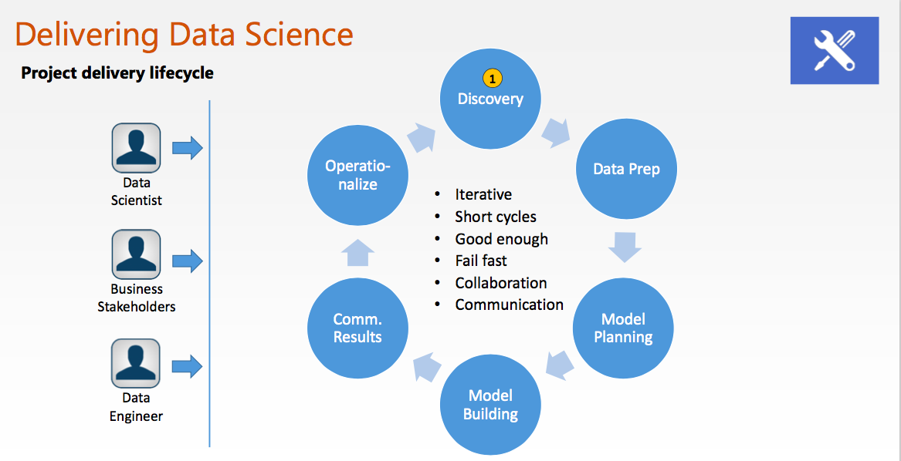
Roles
Source: Univ. of Washington, DS250

Slide 35
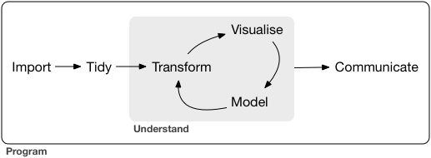
Data analysis workflow
Image: Hadley Wickham, R for Data Science textbook

Slide 36

Common Pitfalls
Sampling bias, correlation vs. causation, randomness
Low quality analytics can produce wrong answers that is worse than no answer at all due to it strategic influence in decision making
Highest quality analytic product is no necessary in every case
Determining the error tolerance of the domain is key
Ideological positions are counterproductive

Slide 37
Case Study: Pricing Experiment

Slide 38
ZipRecruiter Pricing Experiment
Background
Online job matchmaker. Companies pay to list jobs, and ZipRecruiter finds the right candidate to fill the job.
Pricing experiment partnered with Northwestern MBA professor Jean-Pierre Dube
Companies (Ziprecruiter’s customers) enter their details and the job listing, and at the point of sale, Ziprecruiter tested a control price ($99 per listing) vs. nine different prices ranging from $19 to $399
Experiment: We change the price (independent variable) and observe the effect on the total revenue (dependent variable)
Source: http://faculty.chicagobooth.edu/jean-pierre.dube/research/papers/targeted%20pricing.pdf

Slide 39
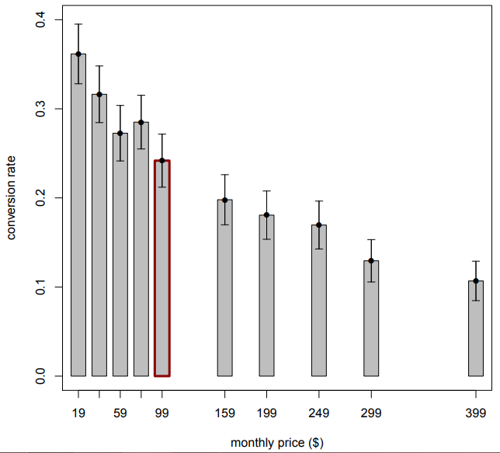
ZipRecruiter Pricing Experiment, cont’d.
Results: Conversion Rate
(See XLS)
Objective:
Find price that maximizes revenue
Source: http://faculty.chicagobooth.edu/jean-pierre.dube/research/papers/targeted%20pricing.pdf

Slide 40
References and Resources
Intro to Business Analytics video
Chicago Booth – Big Data and Marketing Analytics video
Marketo Definitive Guide to Marketing Metrics and Analytics
R for Marketing Research and Analytics textbook
Dube and Misra (2017), “Scalable Price Targeting” research paper

